Slide 1

EXHIBIT C
SPEAKER KIT PRESENTATION

Slide 2

ROADMAP for today
What causes cervical cancer and How can we PREVENT cervical cancer?
What is cervical cancer and who is at risk?
Who should get screened
for cervical cancer?
Why should we follow-up?
1
3
5
2
4
6
Cervical cancer is closer to home than we think.
Who should get the HPV vaccine?
How can you help eliminate cervical cancer in Alabama?
Notes:
Walk you audience through what you will be talking about

Slide 3
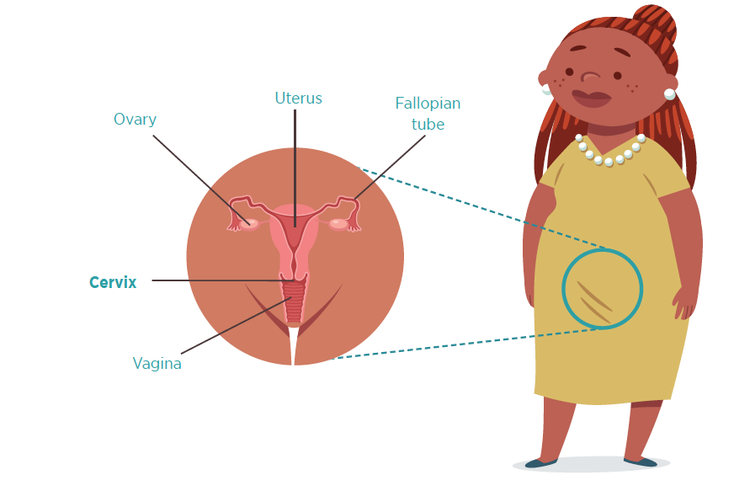
What is cervical cancer?
Cervical cancer happens when abnormal cells begin to grow in the cervix.
It is a very slow cancer that takes years to develop.
Most of the time, women with cervical cancer do not have any symptoms.
Notes:
Explain cervical cancer and emphasize that most of the time there are no symptoms

Slide 4


What is main cause of cervical cancer?
HPV
91%
90%
of cervical cancers are associated with HPV human papilloma virus, a sexually transmitted infection
HPV is extremely common, nearly all sexually active individuals will get the virus at some point in their lives
of HPV infection will clear up on its own. The infection will persist only in a small number of women, putting them at risk for HPV-related cancers.
Unlike a lot of other cancers, cervical cancer does not have anything to do with family history
Notes:
Explain that HPV is very common virus and most people who have been sexually active are exposed to the virus but in most people the infection goes away by itself.

Slide 5

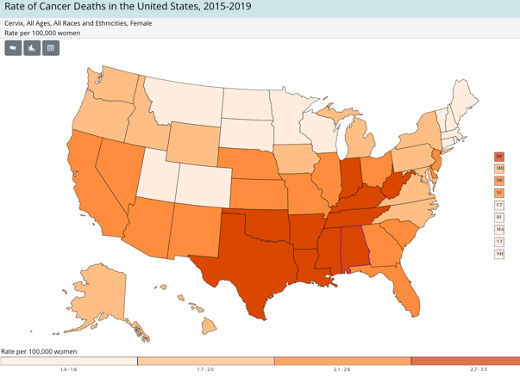

The BAD news
The GOOD news
Alabama has one of the highest death rates from cervical cancer in the United States.
Cervical cancer can be ELIMINATED

Slide 6

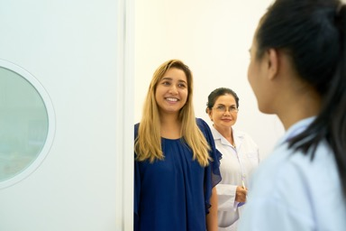

Three Simple Steps …
VACCINATE
Vaccinate your children against HPV infection.
The HPV vaccine is for boys and girls.
2. SCREEN
Get regular screening with the HPV/Pap test for cervical cancer beginning at age 21.
3. FOLLOW-UP/TREATMENT
Follow-up with your health care provider if your HPV/Pap test is abnormal and/or you are asked to come back to the clinic for additional tests.

Slide 7

HPV Vaccination

Slide 8

Step 1: HPV Vaccination (Age 9-26)
80 million adults currently infected with HPV
80% chance of infection in your lifetime
More common than the common cold
HPV Vaccination is safe.
HPV Vaccination works.
HPV Vaccination lasts.

Slide 9
HPV Vaccination Facts
Frequent questions asked by parents about the HPV vaccine
FULL DOSE
The HPV vaccine offers the best protection to girls and boys who complete all the recommended HPV vaccination doses.
EFFECTIVE
Studies have shown that this vaccine provides almost 100% protection against the type of HPV it targets.
SAFE
The HPV vaccine went through years of extensive safety testing before licensed by the FDA.
Side effects are the ones common to most injectable vaccines: sore arm or itching at the site of injection, headache, high temperature, shivery, feeling sick (nausea).
NO COST
It is covered by most health insurance plans. The Vaccines for Children (VCF) program provides vaccines for children 18 years of age & younger who are eligible.
SIDE EFFECTS
Notes:
These are the common questions we get from parents. Make sure to address each of them.

Slide 10



HPV Vaccination: Age & Dose
9-12 YEARS OF AGE
Boys and girls between the ages of 9-12 years should get the HPV vaccine
TWO DOSES
6-12 months apart
13-14 YEARS OF AGE
You can catch up …
TWO DOSES
6-12 months apart
15-26 YEARS OF AGE
Because this is a little later,
teenagers will need 3 doses
THREE DOSES
2nd dose 1-2 months after 1st, and
3rd dose 6 months after the 1st dose.
HPV vaccination is approved by the FDA for adults up to age 45
based on health care provider recommendation.

Slide 11
HPV-Associated Cancers
72%
HPV Virus
Oro-pharyngeal Cancer
Vulvar
Cancer
Cervical Cancer
Vaginal
Cancer
Penile
Cancer
Anal
Cancer
69%
91%
The HPV vaccine
protects against ALL 6 of these cancers!
91%
63%
75%
https://www.cdc.gov/cancer/hpv/cases.html
Notes:
Cancers Caused by HPV | HPV | CDC

Slide 12
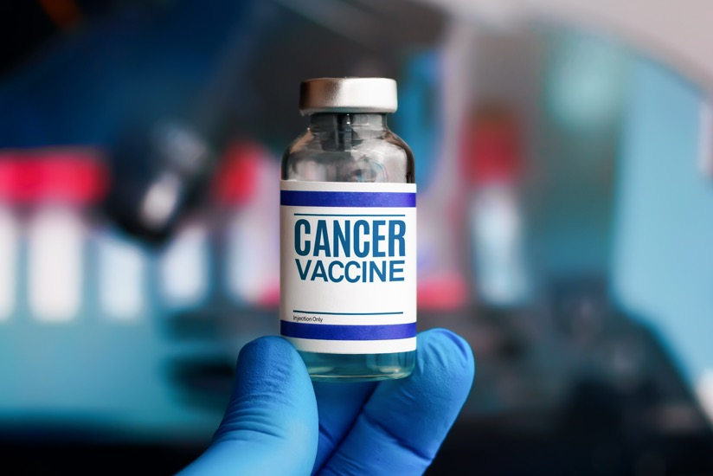
Barriers to HPV Vaccination among Parents
  Lack of information
  Safety concerns/concerns about side effects
  Lack of provider recommendation
  Lack of trust in the health care system
  Not needed or necessary
Agana-Norman et al, 2024; Amboree & Darkoh, 2021; Sonawane et al., 2024
Notes:
The most common barrier is that most parents do not know that there is a vaccine that prevents some cancers.

Slide 13

Every child/adolescent between the ages of 9 and 18 can get the HPV vaccine in Alabama
Most health insurance plans cover HPV vaccination and it not part of your deductible
The Vaccines for Children (VFC) program provides FREE HPV vaccination for uninsured boys and girls between the 9 and 18
For more information about contact your child/adolescent medical provider or the local county health department.

Slide 14
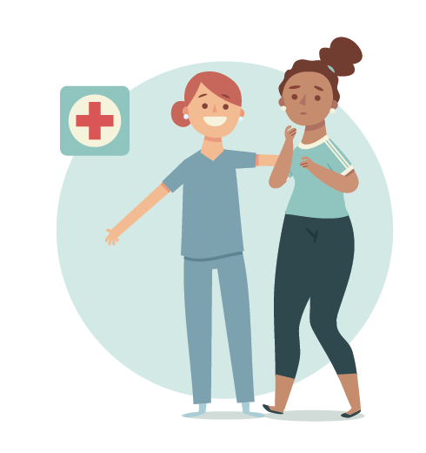
Cervical Cancer Screening

Slide 15
Step 2: Screening
Get Screened regularly beginning age 21
Screening may be every 3-5 years
Ask your doctor about the HPV/Pap Co-test
  Pap test: 60% effective
  Co-test (Pap & HPV test): 98-99% effective
The purpose of cervical cancer screening is to detect changes BEFORE it turns into cancer and thus PREVENTING the disease.

Slide 16
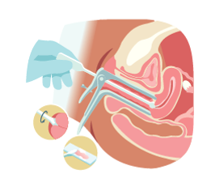
What is Screening?
What Does the Doctor Do During a Screening?
  A tiny brush is introduced through the vagina to get a sample
  The sample is examined in a laboratory to see if there is
  HPV, pre-cancer, or cancer cells
  If there is a finding, your doctor may recommend further follow-up
What is the Difference Between the HPV test, Pap Test and Co-testing?
  HPV test: looks for HPV
  Pap test: looks for changes in the cells (pre-cancer/cancer)
  Co-testing: looks for HPV & changes in the cells (both)
Ask you health care provider what test he/she is performing.

Slide 17
Barriers to Screening
  Limited knowledge that HPV causes cervical cancer
  Lack of awareness that cervical cancer can be prevented
  Lack of perceived risk
  Fear of results
  Competing priorities
  Not knowing where to go
  Lack of awareness of no-cost screening at the local department
  Concerns about lack of confidentiality (small towns)
  Think it is too expensive

Slide 18

Everyone can get screened!
Most health insurance plans cover cervical cancer screening and it not part of your deductible
The Alabama Breast and Cervical Cancer Early Detection Program (ABCCEDP) provides FREE breast and cervical cancer screening and follow-up for low-income and uninsured women
For more information about free screenings, contact ABCCEDP toll-free at 1-877-252-3324 or contact your local county health department.

Slide 19
Cervical Cancer Follow-up/
Treatment

Slide 20
Step 3: Follow-up/Treatment
If abnormal test results, go back to the doctor
Pre-cancer can be removed
Cancer can be removed
Early detection can save your life

Slide 21

Understanding the Cervical Cancer Screening Results
Positive results do not mean the woman has cancer. Remember that screening can detect changes BEFORE it turns into cancer!
It is very important that women follow up and follow the provider’s recommendations, which can be something as simple just watching the changes over time.

Slide 22
Barriers to Follow-Up/Treatment
Only 41% adhere to appointment and get follow/up treatment
Believe cancer is a death sentence
Didn’t realize the purpose of screening or the importance of follow-up/treatment

Slide 23
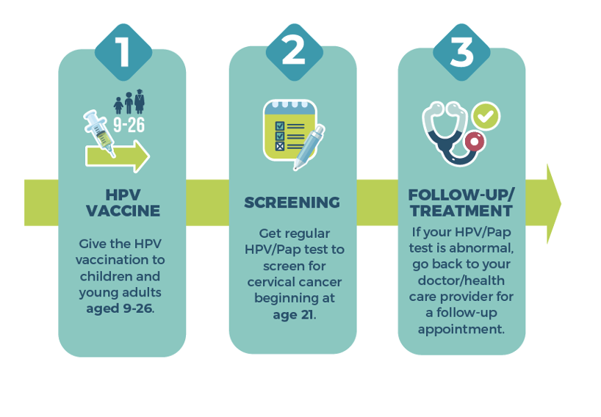
What is OPERATION WIPE OUT?
Statewide effort to eliminate cervical cancer as a public health problem
Alabama continues to be the 1st and only State in the nation to announce such a plan
Notes:
Emphasize the three steps and through three steps we can eliminate cervical cancer.

Slide 24

EVERYONE can play a role…
Get the HPV vaccine for your children and encourage others to do the same
Get screened regularly for cervical cancer
Follow-up if your screening shows any changes
Spread the word
Let’s make the dream of eliminating cervical cancer a reality!

Slide 25
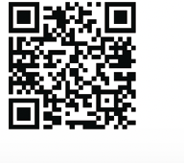
For More Information
WEBSITE
www.operationwipeout.org
SOCIAL MEDIA
Facebook (@Operation WIPE OUT): https://www.facebook.com/operationwipeout
Instagram (@operationwipeoutal): https://www.instagram.com/operationwipeoutal/
X (@OpWipeOutAL):
https://x.com/OpWipeOutAL

